Slide 1
MEDICAL INSURANCE DATA
Presented To: Dr. PRAVIN KASHYAP
Presented By: Students of Group 5

Slide 2
Insurance Cost for a particular person depends on the following factors:
Age
BMI
Gender
Smoker/Non-Smoker
We analyse the variation of Insurance Cost with the given factors and check how they are related.
Notes:
Informative Slide!

Slide 3
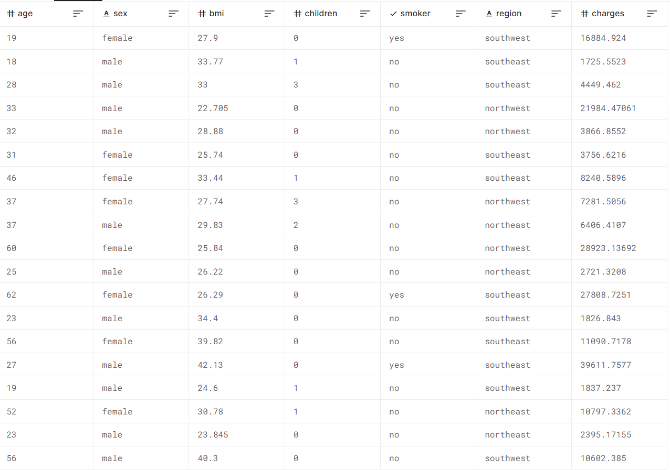
A glimpse at our Dataset!

Slide 4
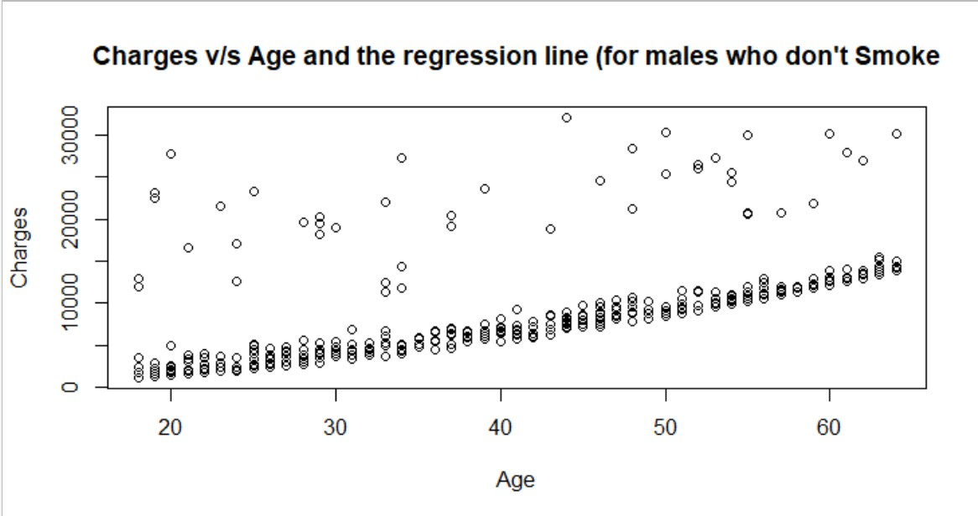
Variation of Charges (For males
who don’t smoke) with Age alone

Slide 5
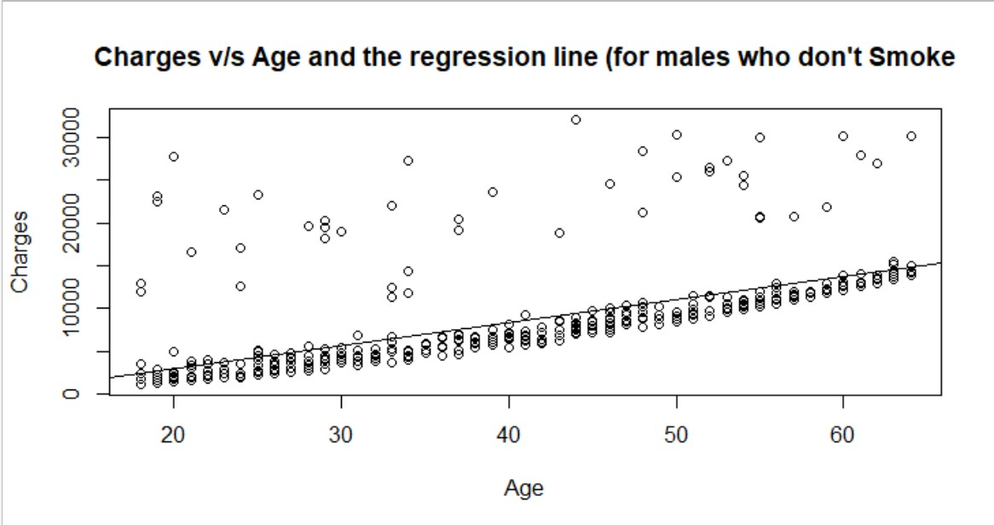
Fitting a Linear regression model for the above plot

Slide 6
REGRESSION LINE EQUATION
Coefficients:
▶ Intercept - 2344.7
▶ Slope - 267.2
▶ Line Equation :
Charges = 2344.7 + (267.2*age)

Slide 7
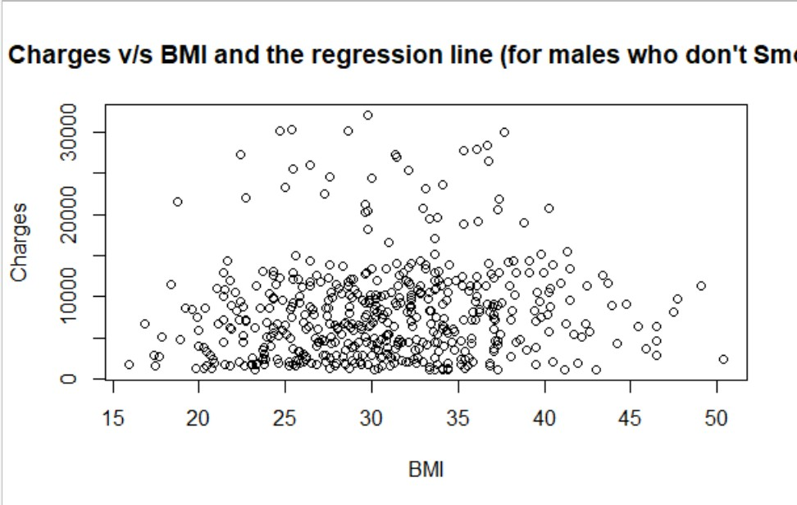
Variation of Charges (For males
who don’t smoke) with BMI alone

Slide 8
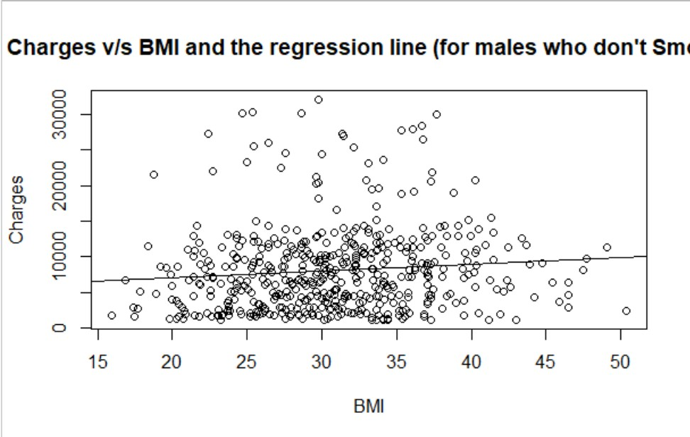
Fitting a Linear regression model for the above plot

Slide 9
REGRESSION LINE EQUATION
Coefficients:
▶ Intercept - 5199.72
▶ Slope- 94.32
▶ Line Equation :
Charges = 5199.72 + (94.32 *bmi)

Slide 10
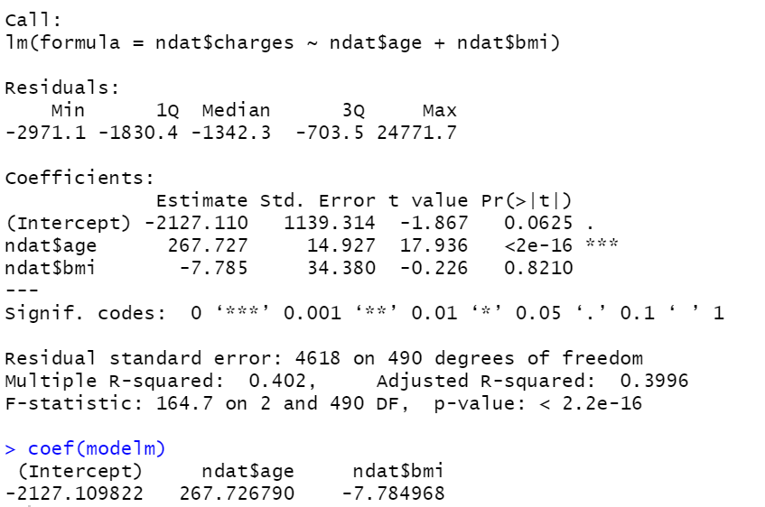
MULTIPLE LINEAR REGRESSION MODEL

Slide 11
MULTIPLE REGRESSION MODEL EQUATION
Dependant Variable – Charges
Independent Variables – age,bmi
Regression Equation:
Charges = -2127.11 + age*267.727 + bmi*(-7.785)

Slide 12
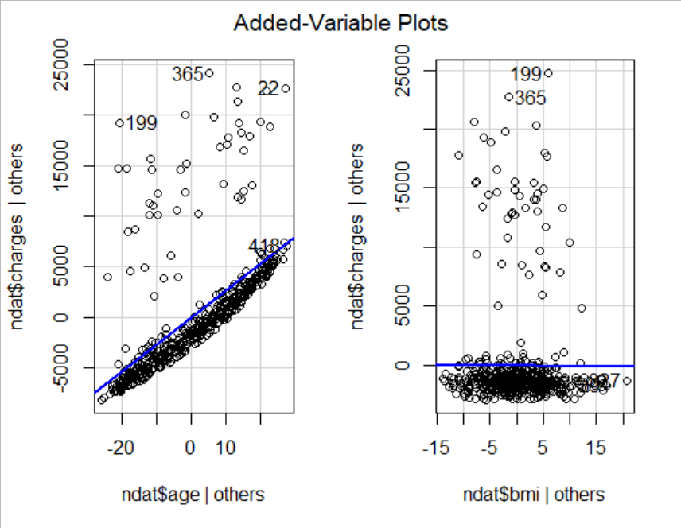
Added Variable Plots for age and bmi with charges

Slide 13
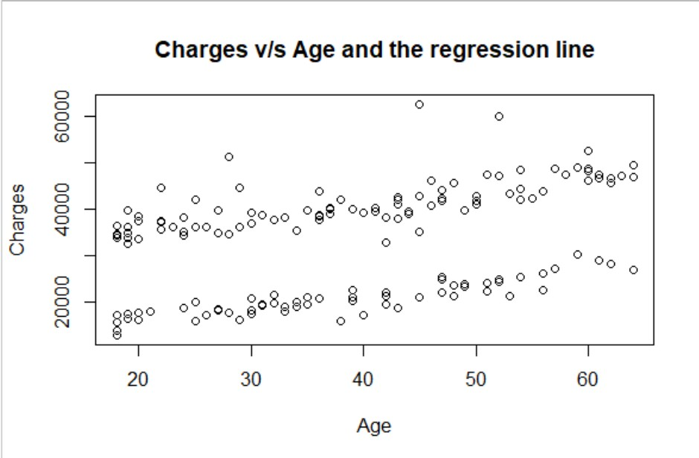
Variation of Charges (For males who smoke) with Age alone

Slide 14
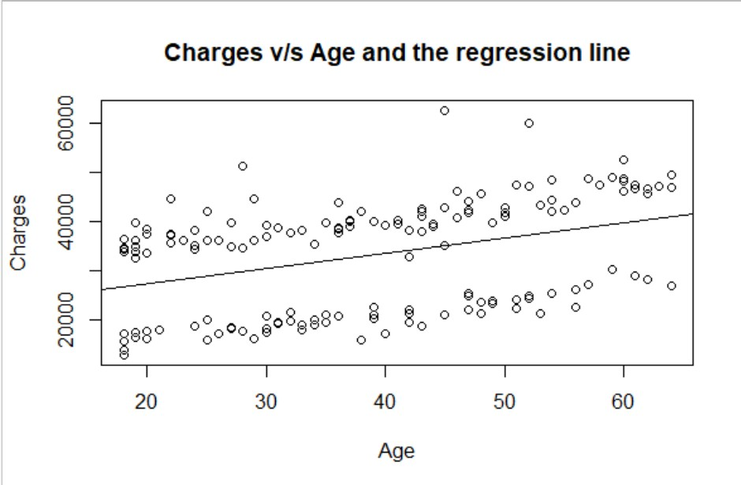
Fitting a Linear regression model for the above plot

Slide 15
REGRESSION LINE EQUATION
Coefficients:
▶ Intercept - 21166.5
▶ Slope- 308.9
▶ Line Equation :
Charges = 21166.5 + (308.9 *age)

Slide 16
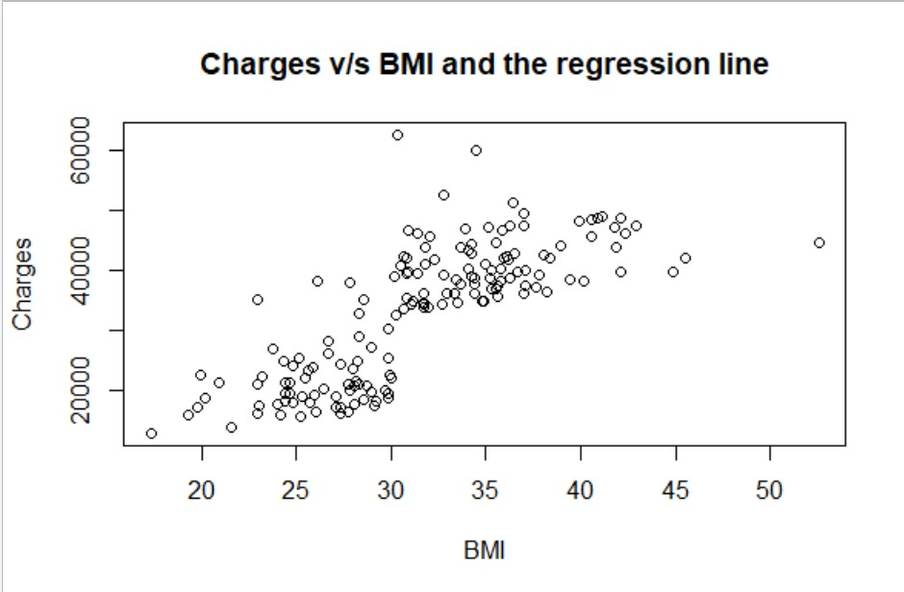
Variation of Charges (For males who smoke) with BMI alone

Slide 17
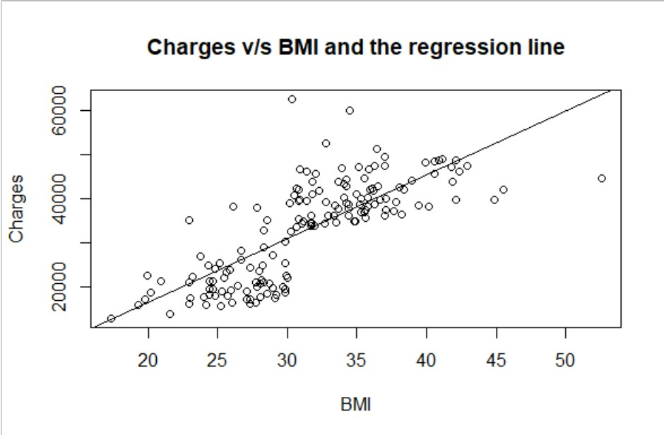
Fitting a Linear regression model for the above plot

Slide 18
REGRESSION LINE EQUATION
Coefficients:
▶ Intercept -> -14075.52
▶ Slope- 1511.55
▶ Line Equation :
Charges = -14075.52 + (1511.55* bmi)

Slide 19
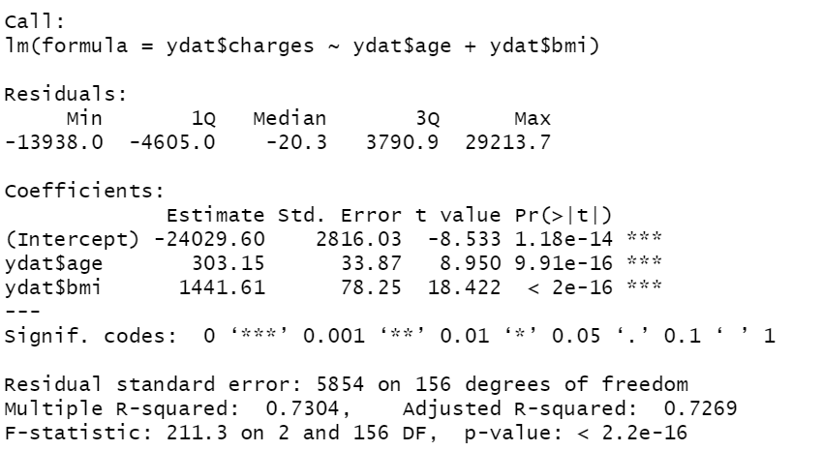
MULTIPLE LINEAR REGRESSION MODEL

Slide 20
MULTIPLE REGRESSION MODEL EQUATION
Dependant Variable – Charges
Independent Variables – age,bmi
Regression Equation:
Charges = -24029.60 + age*303.15 + bmi*(1441.61)

Slide 21
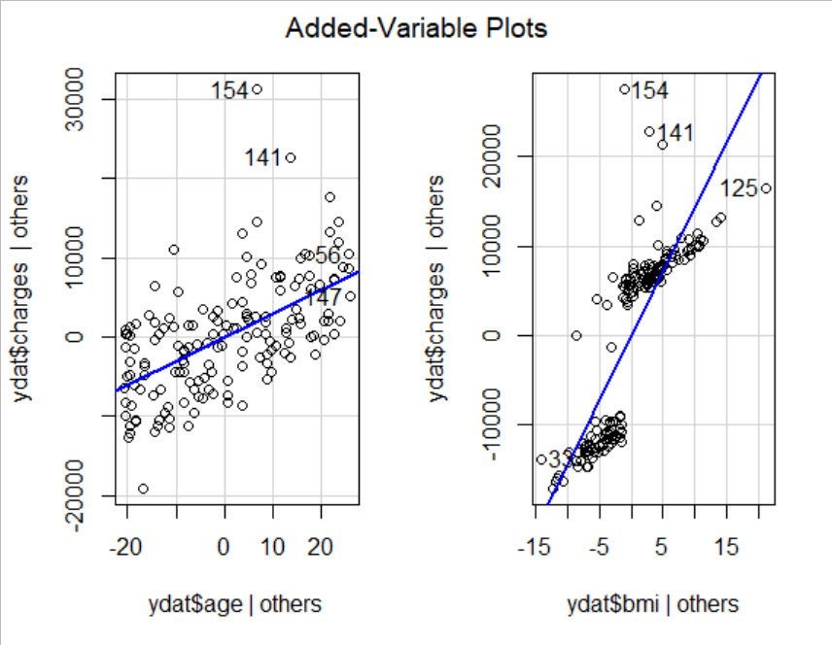
Added Variable Plots for age and bmi with charges

Slide 22
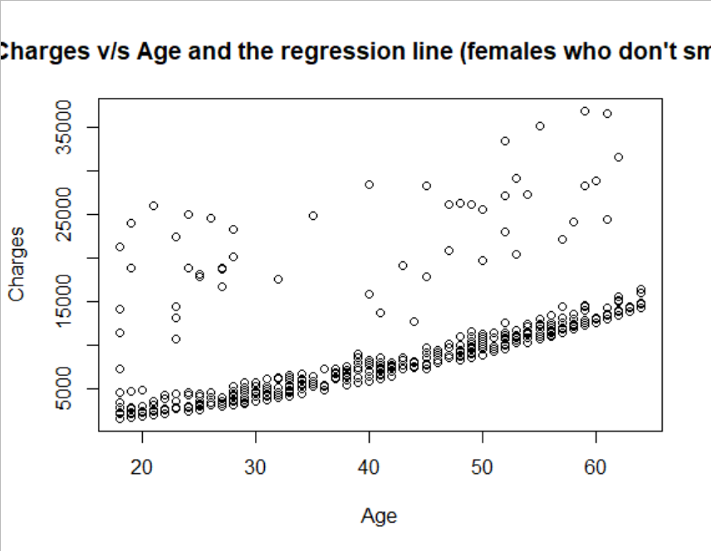
Variation of Charges (For females who don’t smoke) with Age alone

Slide 23
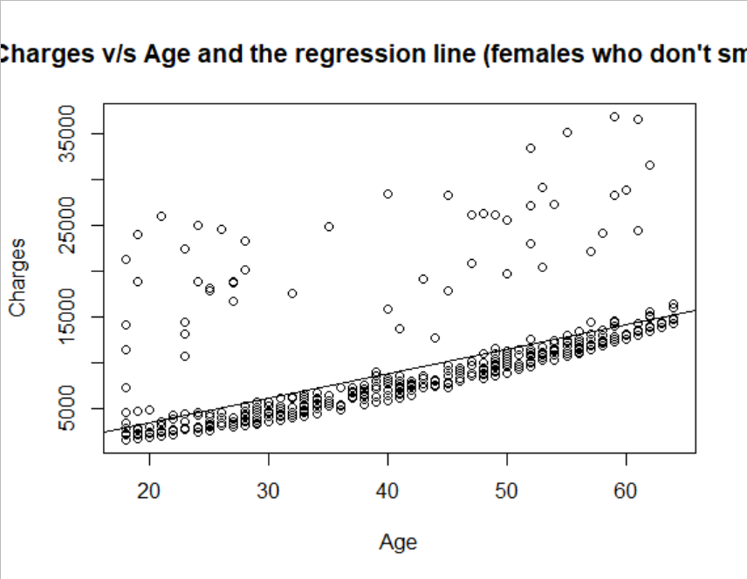
Fitting a Linear regression model for the above plot

Slide 24
REGRESSION LINE EQUATION
Coefficients:
▶ Intercept -1902.2418
▶ Slope - 268.6888
▶ Line Equation :
Charges = 1902.2418 + (268.6888 * age)

Slide 25
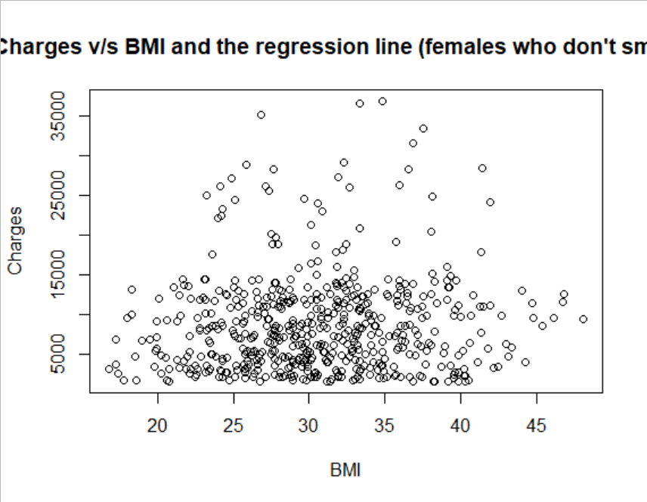
Variation of Charges (For females who don’t smoke) with BMI alone

Slide 26

Fitting a Linear regression model for the above plot

Slide 27
REGRESSION LINE EQUATION
Coefficients:
▶ Intercept - 6407.22480
▶ Slope- 77.11556
▶ Line Equation :
Charges = 6407.22480 + (77.11556 *bmi)

Slide 28
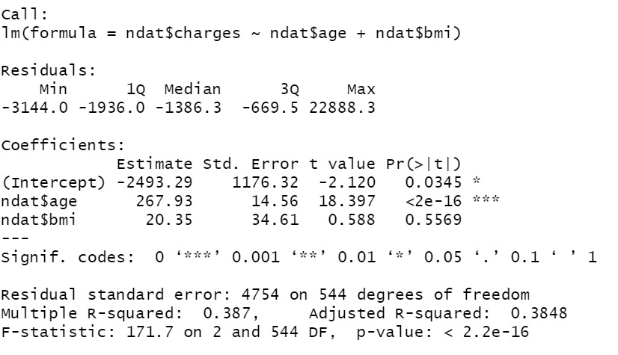
MULTIPLE LINEAR REGRESSION MODEL

Slide 29
MULTIPLE REGRESSION MODEL EQUATION
Dependant Variable – Charges
Independent Variables – age,bmi
Regression Equation:
Charges = -2493.29 + age*267.93 + bmi*(20.35)

Slide 30
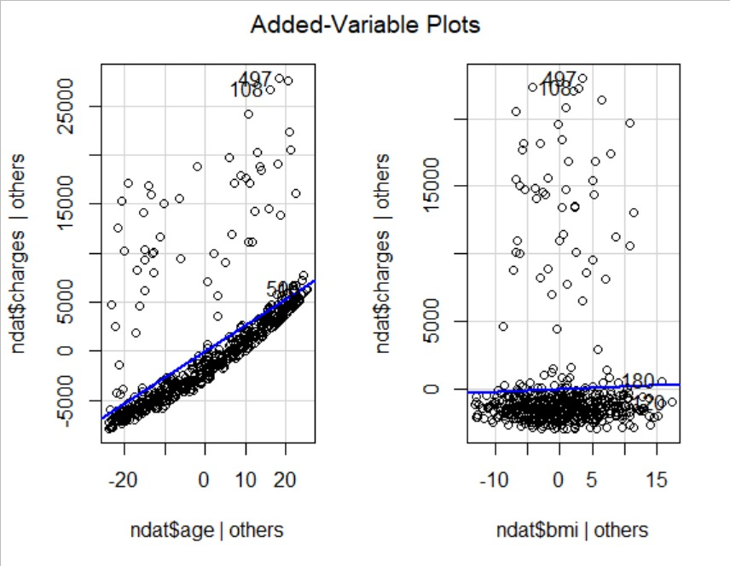
Added Variable Plots for age and bmi with charges

Slide 31
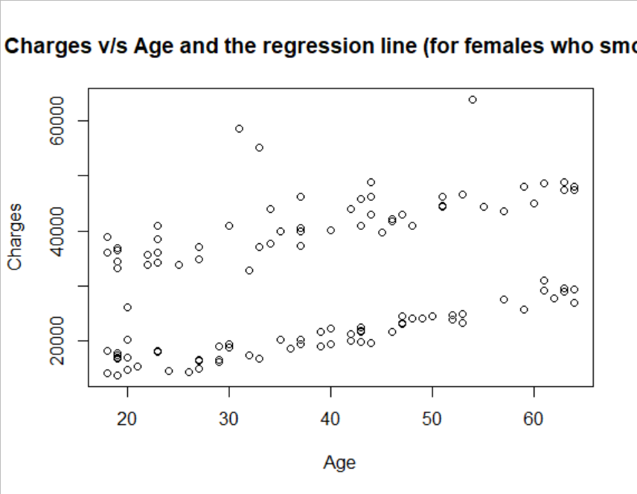
Variation of Charges (For females who smoke) with Age alone

Slide 32
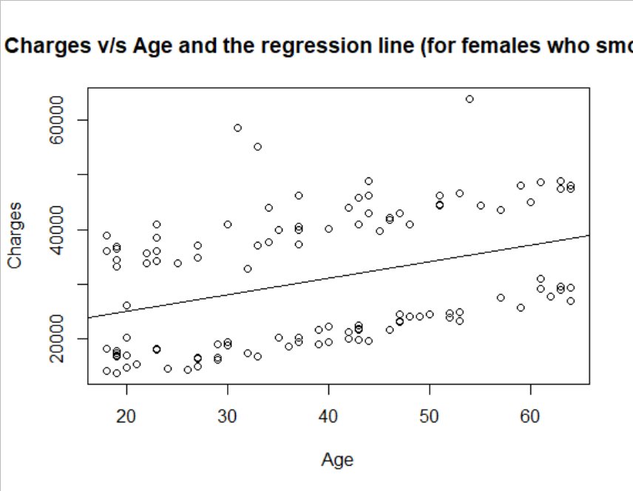
Fitting a Linear regression model for the above plot

Slide 33
REGRESSION LINE EQUATION
Coefficients:
▶ Intercept - 19032.953
▶ Slope - 301.643
▶ Line Equation :
Charges = 19032.953 + (301.643 * age)

Slide 34
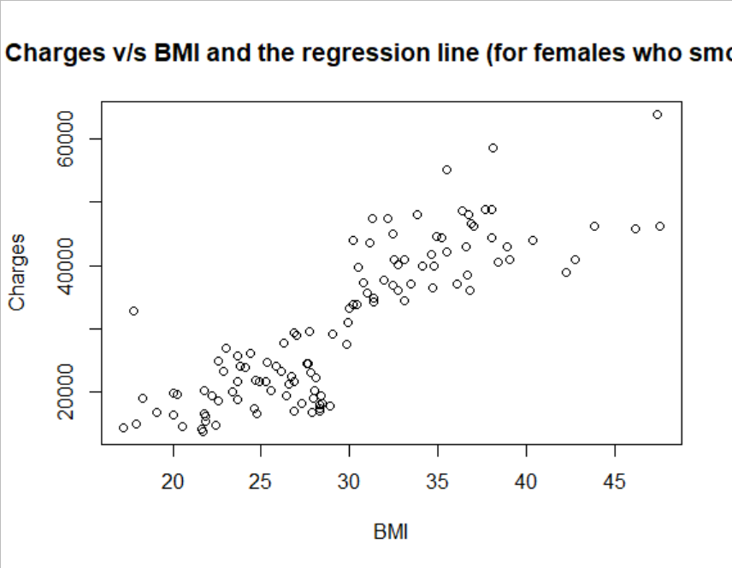
Variation of Charges (For females who smoke) with BMI alone

Slide 35
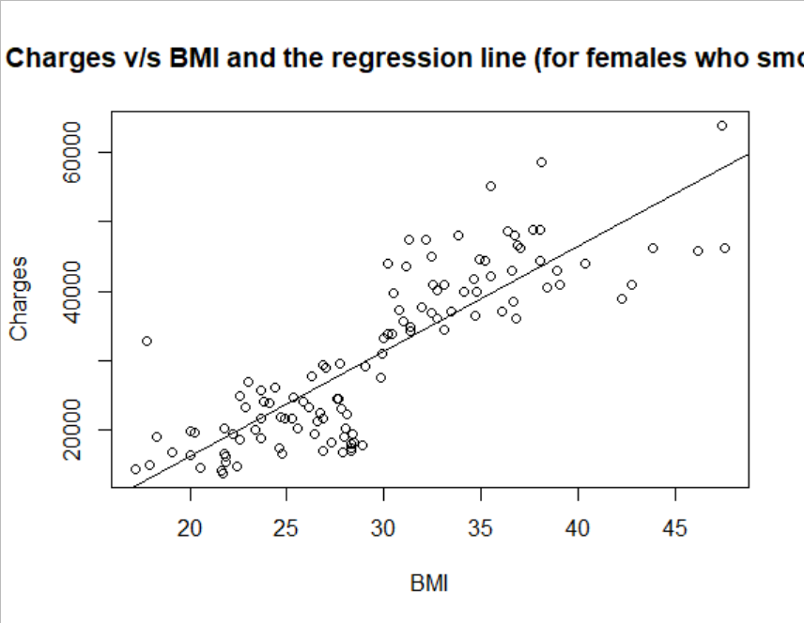
Fitting a Linear regression model for the above plot

Slide 36
REGRESSION LINE EQUATION
Coefficients:
▶ Intercept - 14075.516
▶ Slope- 1511.555
▶ Line Equation :
Charges = 14075.516 + (1511.555*bmi)

Slide 37
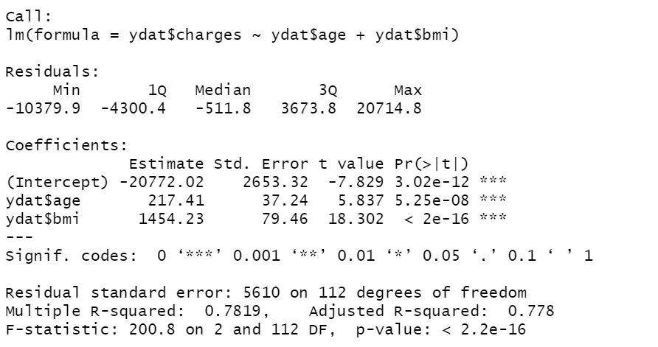
MULTIPLE LINEAR REGRESSION MODEL

Slide 38
MULTIPLE REGRESSION MODEL EQUATION
Dependant Variable – Charges
Independent Variables – age,bmi
Regression Equation:
Charges = -20772.02 + age*217.41 + bmi*(1454.23)

Slide 39
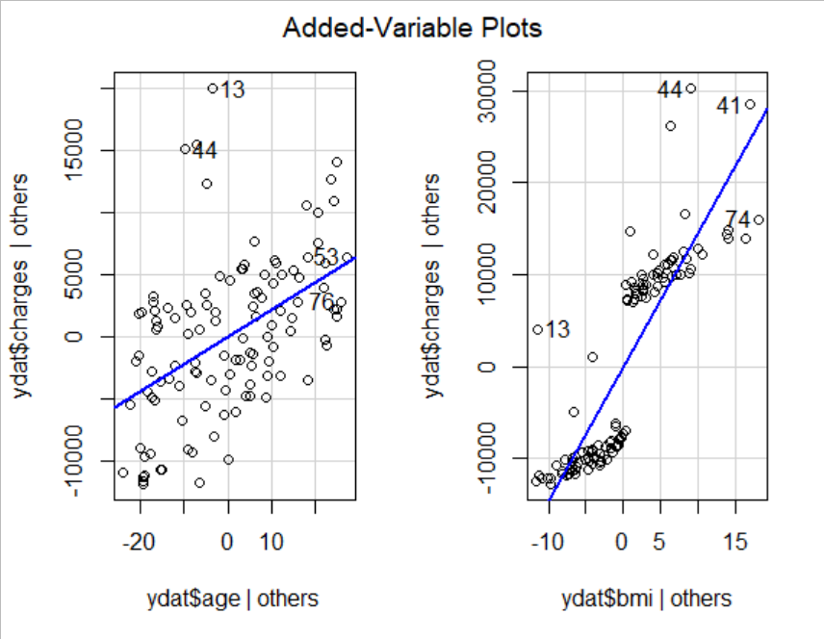
Added Variable Plots for age and bmi with charges

Slide 40
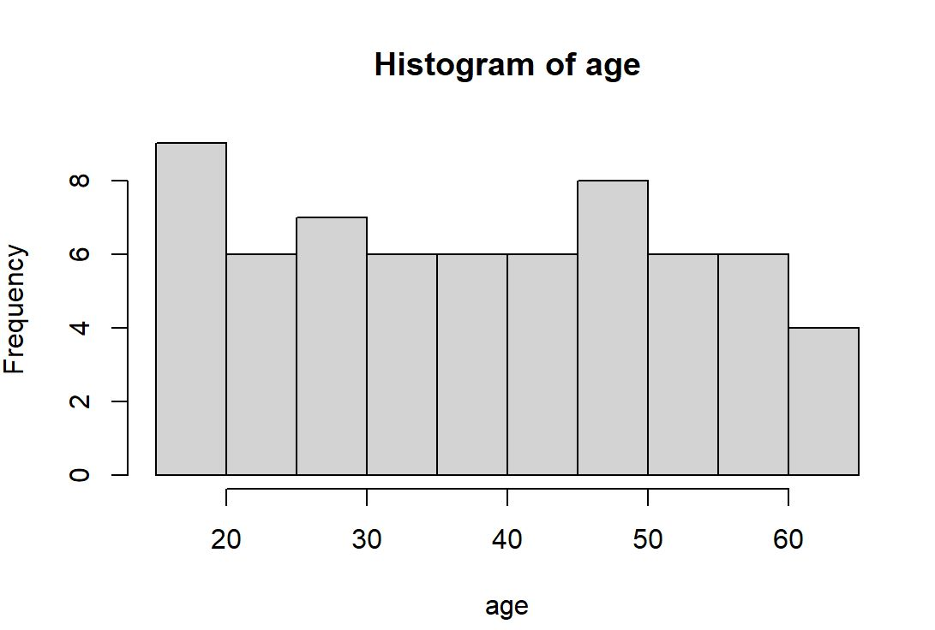
Analysis of smokers with respect to gender, age and BMI.
HISTOGRAMS
Distribution of the number of Male smokers with Age

Slide 41
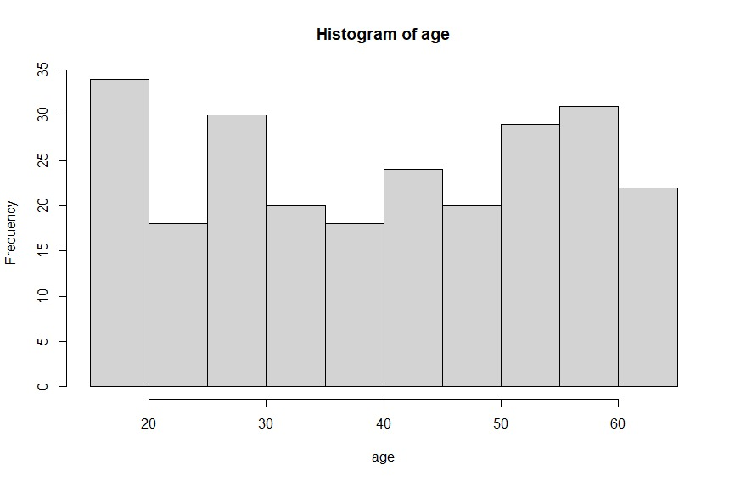
Analysis of smokers with respect to gender, age and BMI.
HISTOGRAMS
Distribution of the number of Female smokers with Age

Slide 42
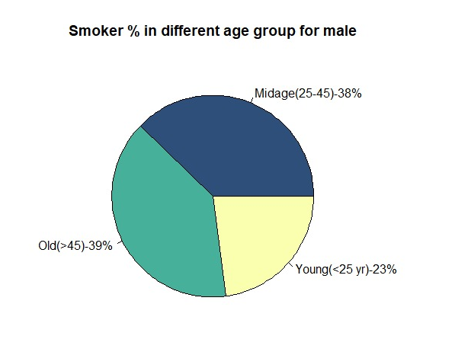
Analysis of smokers with respect to gender, age and BMI.
PIE-CHARTS
Distribution of the number of Male smokers with different age groups

Slide 43
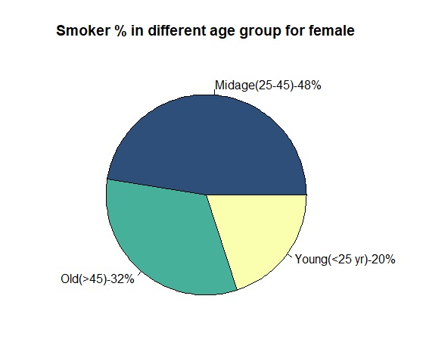
Analysis of smokers with respect to gender, age and BMI.
PIE-CHARTS
Distribution of the number of Female smokers with different age groups

Slide 44
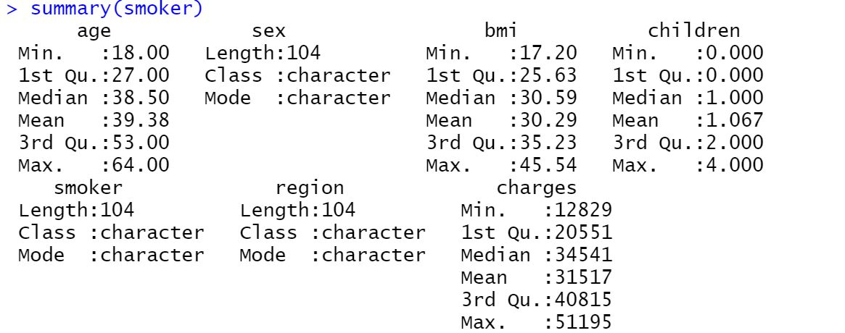
SUMMARY

Slide 45
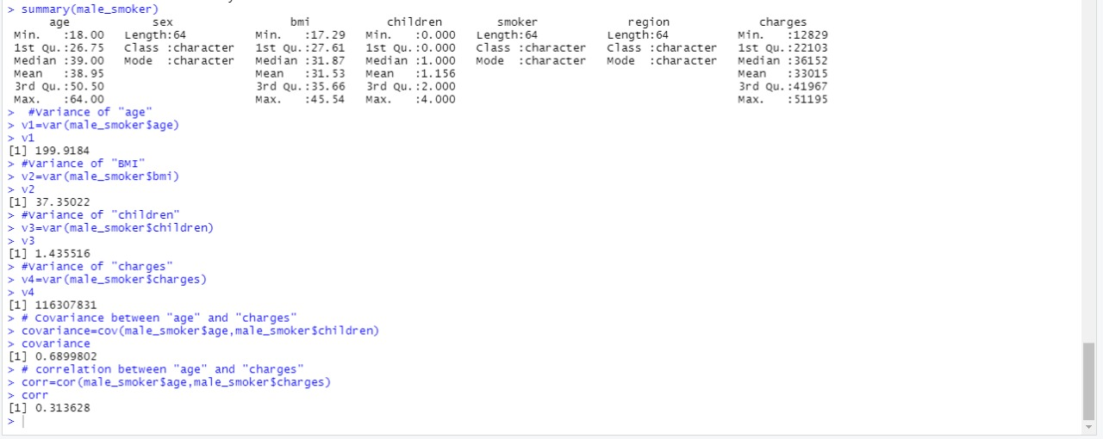
Detailed Summary of Male Smokers

Slide 46

Detailed Summary of Female Smokers

Slide 47
A Presentation by members of Group 5:
R T Surya
Pranav Karrtik Mohanasundaram
Ayush Gupta
Deb Deep Bose
Chandanam Saketh Krishna
Dhawal Duggar
Kritika
Thank You!

